Slide 1
N Queens Problem
Problem Definition: To Implement N Queen's problem using Back Tracking.
Prepared By
Arati Shahapurkar
Asst. Prof.Dept of C.S.E
K.L.S G.I.T Belagavi

Slide 2
Objective of the Experiment
To introduce Backtracking method
Present with working of Backtracking
To place N queens on N*N chessboard
without attacking each other
CSE@GIT

Slide 3
Backtracking
Backtracking is a general algorithm for finding some (or all ) solutions to complex problems
Backtracking algorithm explores all initially options to the solutions, only recursively explores the promising options and abandons each non promising options
Until exhausting the rest of the promising options in the state space tree
CSE@GIT

Slide 4
Application of Backtracking
Generating permutations or combinations
The Eight queens puzzle (given a 8×8 chess board find all ways of placing 8 queens on the board such that they do not attack each other)
Generating Cartesian products of sets
Longest prefix problems
CSE@GIT

Slide 5
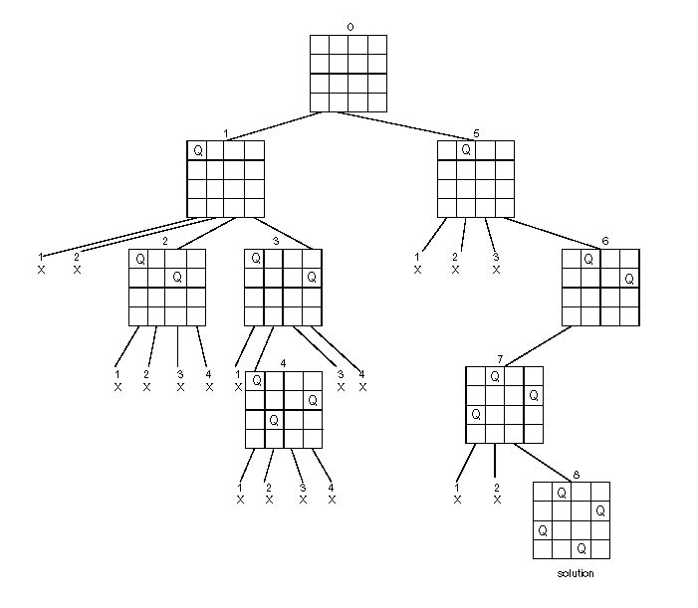
State Space Tree for
N Queens Problem

Slide 6
Algorithm NQueens (k, n)
//Using backtracking, this procedure prints all possible placements of n queens
//on an n x n chessboard so that they are non-attacking
{
for i ← 1 to n do
{
if(Place(k,i) )
{
x[k] ← i if (k=n) write ( x[1...n]) else Nqueens (k+1, n)
}
}
}

Slide 7
Algorithm Place( k, i)
//Returns true if a queen can be placed in kth row and ith column. Otherwise it
//returns false. x[] is a global array whose first (k-1) values have been set. Abs(r)
//returns the absolute value of r.
{
for j ← 1 to k-1 do
{
if ( (x[j]=i or Abs(x[j]-i) = Abs(j-k) )
{
return false
}
}
}

Slide 8
Example
F | F | F | F | F
Q
Q
 |  | F | F | F
Q
 |  | Q

Slide 9
Example
Q
 |  | Q
 |  |  |  | F
Q
 |  | Q
 |  |  |  | Q
Q
 |  | Q
 |  |  |  | Q
 | F
Q
 |  | Q
 |  |  |  | Q
 | Q

Slide 10
Example
Q
 |  | Q
 |  |  |  | Q
 | Q
 |  |  | F
Q
 |  | Q
 |  |  |  | Q
 | Q
 |  |  | Q
DONE

Slide 11
Possible Solution Set
Q
 |  | Q
 |  |  |  | Q
 | Q
 |  |  | Q
Q
 |  |  | Q
 | Q
 |  |  |  | Q
 |  | Q
 | Q
 |  |  | Q
Q
 |  | Q
 |  |  |  | Q
 | Q
 |  |  |  | Q
 |  | Q
Q
 |  |  | Q
 |  | Q
Q
 |  |  | Q
 | Q
 |  |  |  | Q
 |  | Q
 |  |  |  | Q
 | Q
 |  |  | Q
Q
 |  |  | Q
Q
 |  | Q
 |  |  |  | Q
 | Q
 |  |  | Q
 | Q
 |  |  |  | Q
 |  | Q
Q
 |  |  |  | Q
 | Q
 |  |  | Q
Q
 |  | Q
 |  |  |  | Q
 |  | Q
Q
 |  |  | Q
 | Q
All possible solutions for N=5

Slide 12
Psedocode of N Queens problem
Place the queens col­umn wise, start from the left most column
If all queens are placed.
return true and print the solu­tion matrix.
Else
Try all the rows in the cur­rent column.
Check if queen can be placed here safely if yes mark the cur­rent cell in solu­tion matrix as 1 and try to solve the rest of the prob­lem recursively.
If plac­ing the queen in above step leads to the solu­tion return true.
If plac­ing the queen in above step does not lead to the solu­tion , BACKTRACK, mark the cur­rent cell in solu­tion matrix as 0 and return false.
If all the rows are tried and noth­ing worked, return false and print NO SOLUTION.

Slide 13
Program
#include<stdio.h>
#include<conio.h>
#include<math.h>
int a[30],count=0;
//row= index & column=value ie i=row and a[i]=column
int place(int pos)
{
int i;
for(i=1;i<pos;i++) //from 1st row to (current row-1)to check with all prev queens
{
if((a[i]==a[pos])||((abs(a[i]-a[pos])==abs(i-pos))))
return 0; //if a queen exists in same column or diagonally
}
return 1;
}
void printsol(int n)
{
int i,j;
count++;
printf("\n\nSolution #%d \n\n",count);
for(i=1;i<=n;i++)
{ for(j=1;j<=n;j++)
{ if(a[i]==j) printf("Q\t");
else printf("*\t");
}
printf("\n");
}
}

Slide 14
void queen(int n)
{
int k=1;
a[k]=0;
while(k!=0)
{
a[k]=a[k]+1;
while(a[k]<=n && !place(k)) //while columns are left and k cant be placed
a[k]++;
if(a[k]<=n)
{
if(k==n)
printsol(n);
else
{
k++;
a[k]=0;
}
}
else
k--;
}
}
void main()
{ int n;
printf("Enter the Number of queens\n");
scanf("%d",&n);
queen(n);
printf("\nTotal Number of Solutions=%d",count);
}

Slide 15
The power of the set of all possible solutions of the n queen’s problem is n! and the bounding function takes a linear amount of time to calculate, therefore the running time of the n queens problem is O (n!).
Complexity of N queens problem

Slide 16
Learning Outcome of the Experiment and Conclusion
At the end of the session, students should be able to :
Explain the concept of Backtracking [L2, CO 3, PO3]
Demonstrate the working of NQueens problem using backtracking [L3, CO 2,3, PO3]
Estimate all solutions for the given n value
[L5, CO 2, PO3,4]

